Slide 1
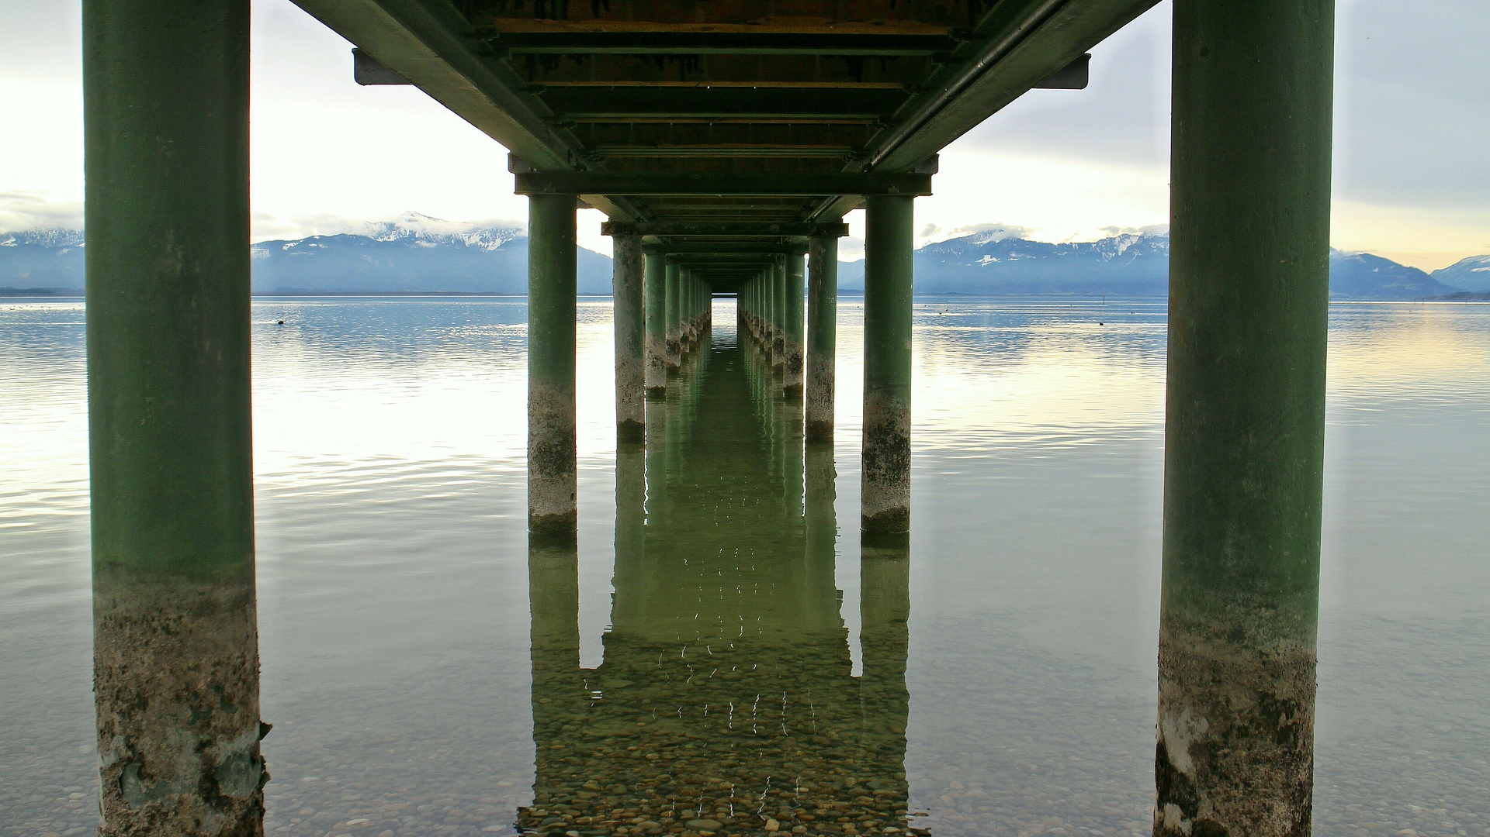
CONTEXT IS EVERYTHING
BQ1 Foundations Lesson 9
I can explain the implications of Beau Lotto’s statement that ‘context is everything’
Notes:
See how this lesson links to the course by viewing the final slide
Key TOK terms appear in a red font

Slide 2
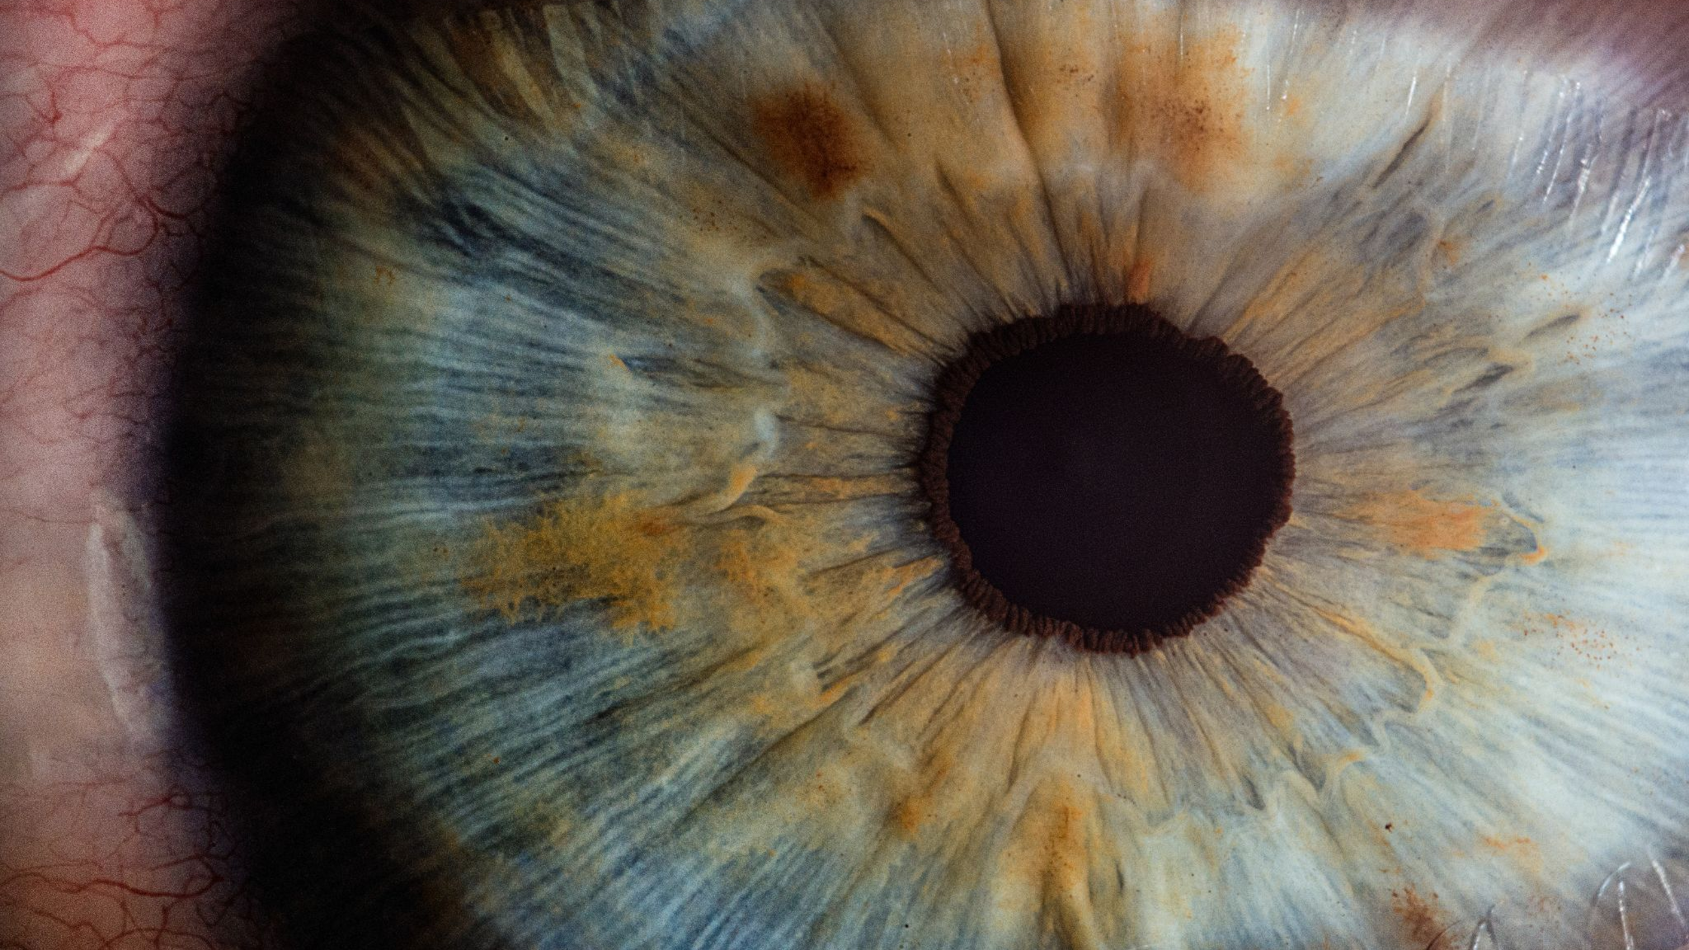
Starter
How truthful is the information your senses are giving you about reality right now? How certain can we be about that question?
Notes:
A good chance to talk about how there are more than just 5 senses.
Eg - balance (equilibrioception), temperature (thermoception), kinesthetic sense (proprioception), pain (nociception), and internal senses - hunger, needing to use the bathroom, etc.

Slide 3
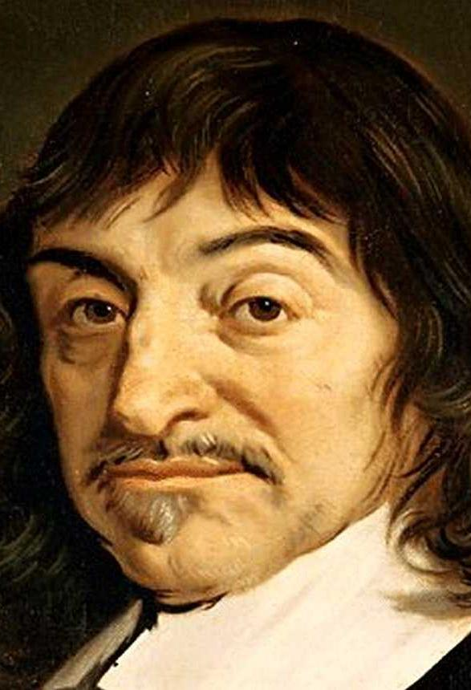
Write, Pair, share
“The senses deceive from time to time, and it is prudent never to trust wholly those who have deceived us even once.”
What do you think Rene Descartes mean?
To what extent should we follow his advice?
Notes:
If we are going to mistrust the senses, how far should we (can we) take this?
Link back to rationalism vs empiricism, which we explored in Descartes vs. Locke..

Slide 4
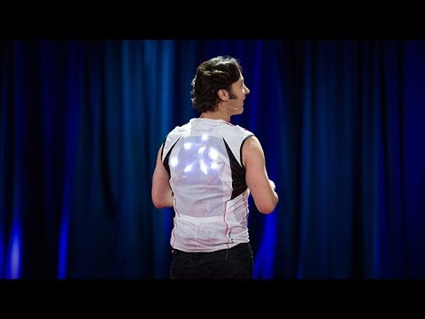
David Eagleman on sense perception
Copy the quote:
“your brain is locked in a vault of silence and darkness in your skull”
Discussion: What point do you think neuroscientist David Eagleman was making about the information our brains receive from our senses?
Watch the video clip. Write an answer.
Notes:
Animated slide. Reveal the quote and question 1.
After students have tried to figure out his meaning (ie the brain is not directly connected to the outside world, and only serves to interpret electro-chemical impulses sent to it), watch from 5.34 - 6.15, from the point where he says “Well, here's the big secret…” This explains that in more detail.

Slide 5
Pair, watch, share
Watch this video.
What happens to the way we see the image of the castle?
Why do you think this is happening? Write down a hypothesis to explain. Link it to Eagleman if you can.
Notes:
Video is here.

Slide 6
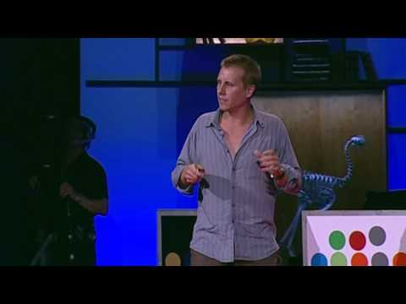
Beau Lotto on sense perception
Copy the quote:
‘Context is everything’
Make sure you can explain what he means by the end of his talk.
Add to your hypothesis from the last slide.
Notes:
Watch video from 1.29 ‘til the bees (around 9.30). It would be good to demonstrate via Microsoft Paint (or similar) that the colours in Lotto’s cube really are grey, rather than yellow and blue, because students will not be able to believe this. This can be done by selecting the colour, and filling a square. The students will know how to do this - call on a volunteer!
If time, you can also watch Al Seckel’s illusions as well (particularly the ‘crazy nuts’ one - what does this tell us about how we can’t overcome the mistakes made by the brain?).
There are hundreds more awesome visual illusions that you can play around with; students themselves can offer them. One of the most famous ones from recent years is the blue vs. gold dress.

Slide 7
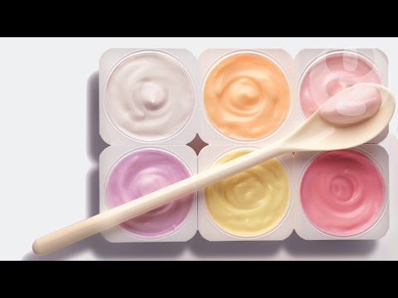
Is context everything… just for the way we see?
Watch the yoghurt experiment video. What does it reveal about our sense of taste?
Notes:
Video is here.
It works in the same way… we base our knowledge of taste on context - the colour of the yoghurt determines how we taste it.
It doesn’t make sense (for most of the volunteers) that the taste should be unrelated to the colour.

Slide 8
Before & after
Go back to your starter question. Would you still give the same answer?
On your tables, design a display to show how today’s lesson has changed your understanding about the way we interact with reality..
Include as many of the following terms as you can: truth, context, direct connection, interpretation, senses, brain, subjective, objective.
Include plenty of images to express your ideas.
Notes:
For example -
We construct our own ‘subjective truth’ about reality according to the context in which we sense things.
There is no direct connection between the world and our brain, and the information provided by the senses is essentially meaningless electrochemical messages.
The brain simply interprets those messages according to what seems to be useful.
This almost certainly means that there is no objective reality out there - we all see reality in a different way.

Slide 9
Links to the TOK exhibition
Related exhibition prompt What counts as knowledge (IAP-1)?
Refer to the ideas from this lesson to answer this question.
For example, think about the different aspects of the ‘JTB’ definition of knowledge. Does this give us an answer to this IA prompt? Is one aspect of ‘JTB’ more important than others? Do we need a different definition?
Which objects could help to illustrate your answer?
Notes:
Optional slide, if you want to help students to take ownership of the IA prompts (IAPs) for the TOK exhibition
For more ideas on relevant IAPs, see the ‘Linking this lesson to the course’ slide

Slide 10
What did Beau Lotto mean when he said ‘context is everything’, and what are the implications of this?
Notes:
See the BQ1 assessment tracker for suggestions on providing feedback, and recording students’ progress

Slide 11
Linking this lesson to the course
During this lesson, we consider the highlighted aspects of the TOK course
The images used in the presentation slides can also give students ideas about selecting exhibition objects; see also our link below to specific IA prompts
CORE THEME | OPTIONAL THEMES | AREAS OF KNOWLEDGE | TOK ASSESSMENT
Knowledge & the knower | Indigenous societies | The arts | The TOK essay
 | Language | History
 | Politics | The human sciences | The TOK exhibition Could be linked to IAP-15 (constraints), 20 ( experience)
 | Religion | Mathematics
 | Technology | The natural sciences

Slide 12
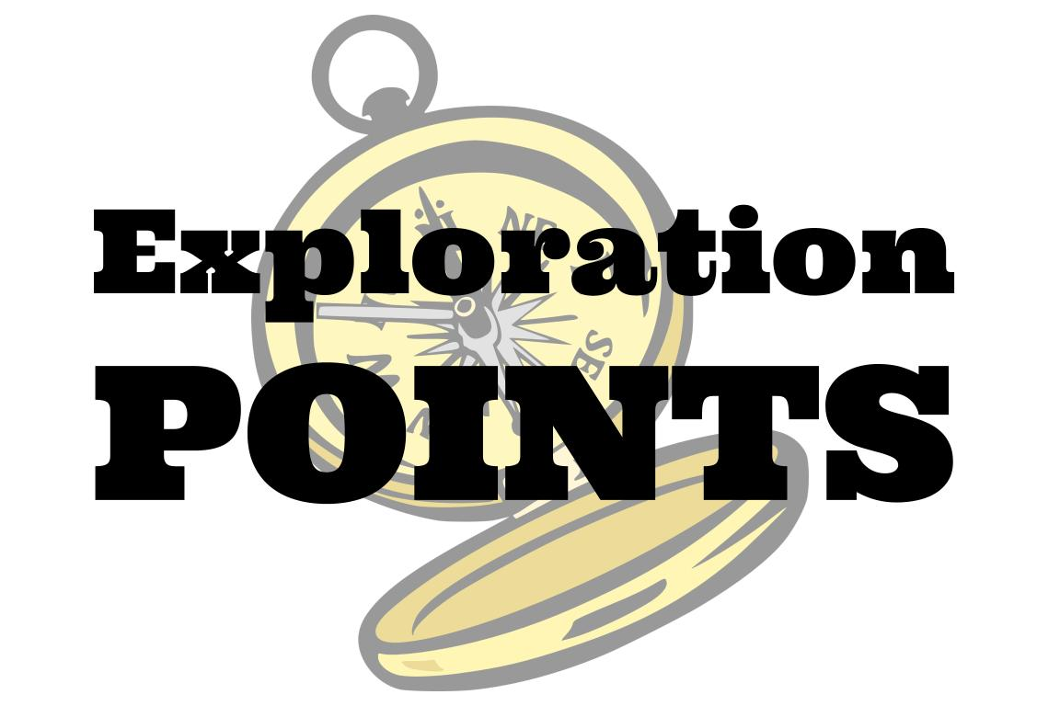
Explore the TOK themes and areas of knowledge in more depth via a range of thinkers, media sources, and other resources, in our EXPLORATION POINTS DOCUMENTS.
Access the documents via the links below. You’ll also find the EP icons on all of the TOK course pages of the site to help you unpack the quotes, KQs, and real-life situations that you find there.
CORE THEME
Knowledge & the knower
OPTIONAL THEMES
Indigenous societies
Language
Politics
Religion
Technology
AREAS OF KNOWLEDGE
The arts
History
Human sciences
Mathematics
Natural sciences
Notes:
Use this slide to access the ‘Exploration Points’ notes for BQ1, which will help students to develop a deeper knowledge of any TOK theme or area of knowledge. This will not only help them to master the TOK course in general, but also craft a great exhibition or essay.
Be ready to provide more guidance on how to use this resource - ie, which media sources to focus on, which questions to address, which TED talks to watch, and which key terms and ideas to understand.

